Slide 1

Moukthika Guntha, Nethra Mugala, Rama Chittella, Bhargava Charan, Surya Praharsha

Slide 2
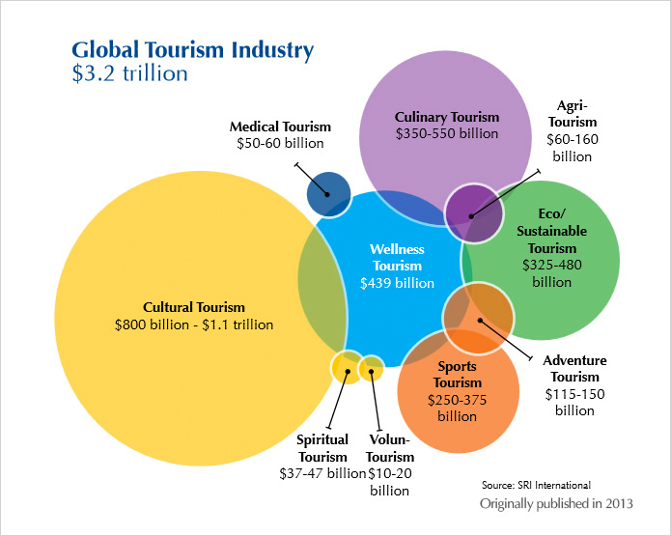
Target Market and Value Propositions
Our main target would be cultural tourism.
Our Product provides professional services with easy payment processing(cash free) and immediate response.
The customer experiences service without borders thereby eliminating frustrations of travel.

Slide 3


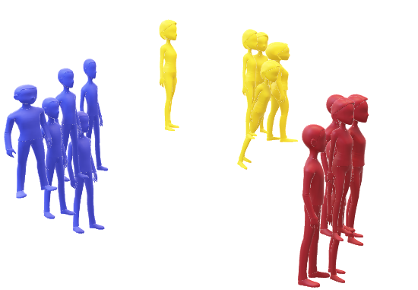

The Struggle is real
The tourist may not understand what the guide is saying
The guide may not be able to communicate effectively even though he knows the language that the tourist understands
여보세요

Slide 4
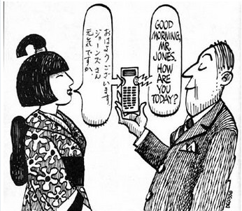

Our Solution
Ensuring a two way communication between the tourist and the guide.
여보세요
Hi
LOCUS
LOCUS
LOCUS
こんにちは
hola
LOCUS
guide
ciao

Slide 5
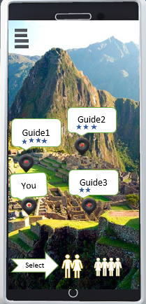
Features
Connecting Guides and Tourists
Real-Time two way Communication
Choosing Guides based on Rating, Range and availability

Slide 6

Capabilities
Security
One to many Communication
Online Cashless Payments
Low Cost Service and User Friendly

Slide 7

WHY WE ARE BEST?
Providing tourists the flexibility to chose the way they want to communicate with the guide.
Apps like Papago, iTranslate etc does not provide the feature of connecting Tourists and Guides.
It is most important for the guide and the tourist to know who they are meeting. A rating system improves the security of both guide and tourist.
Sign in as:
Tourist
Guide

Slide 8
Our Prototype
Developed Android application.
We are maintaining our database using Firebase.
We have used GoogleMapsAPI for creating Maps .
Used Speech-to-Text API to Convert voice to text output.
Guides and Tourists will be able to register and login.
Tourists will be able to select guides from the available guides.
Tourists will be able to see the availability of guides on the map.

Slide 9
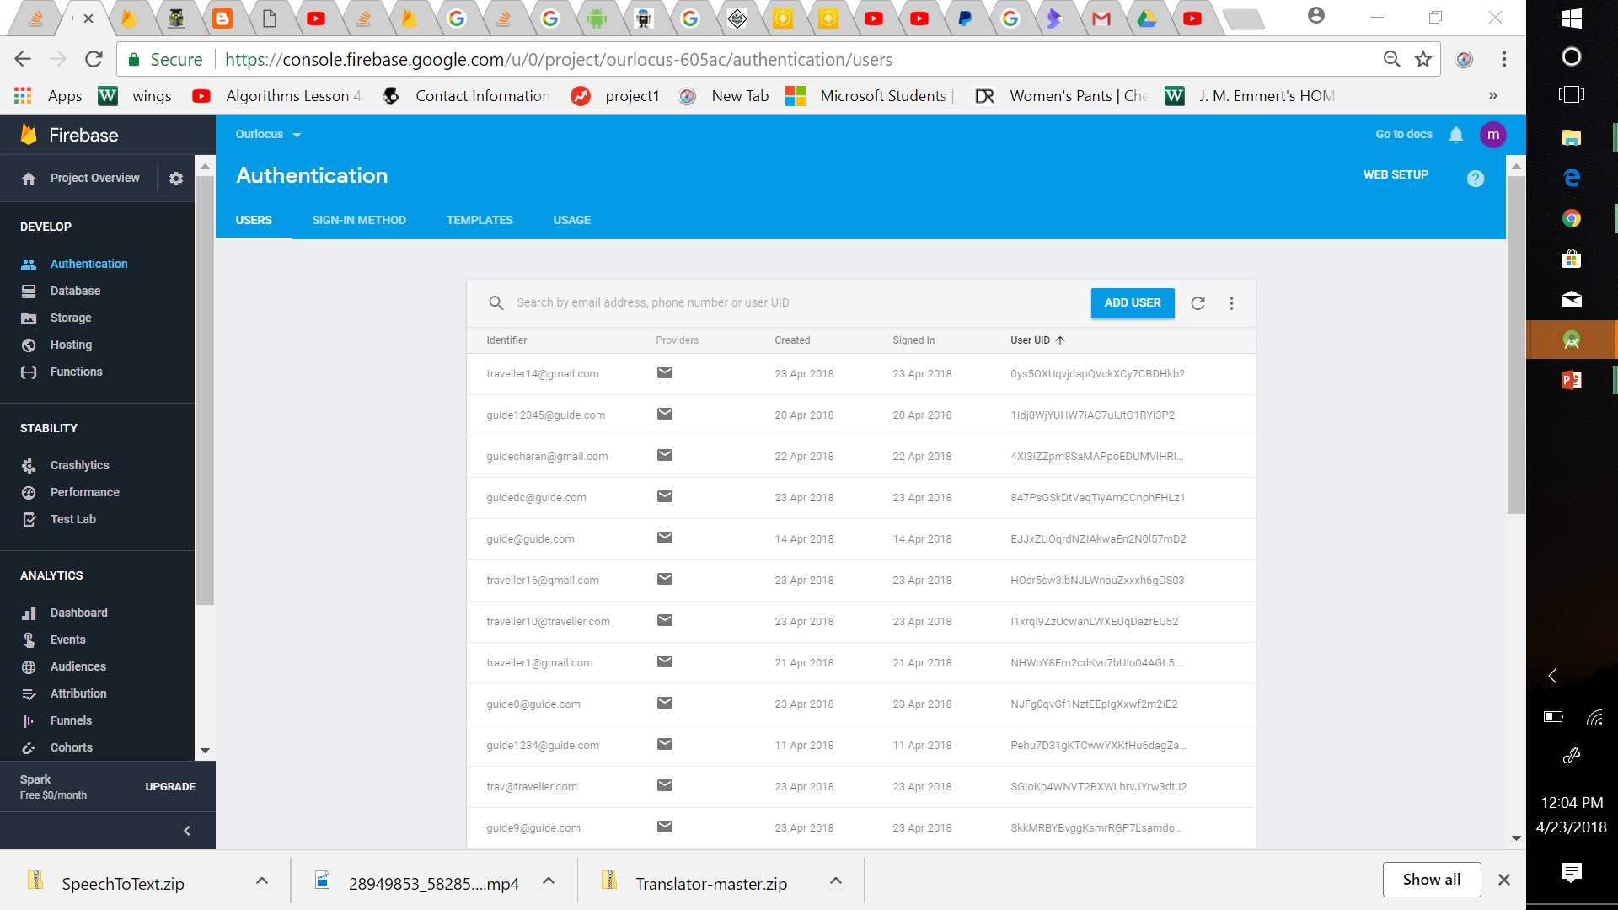

Slide 10
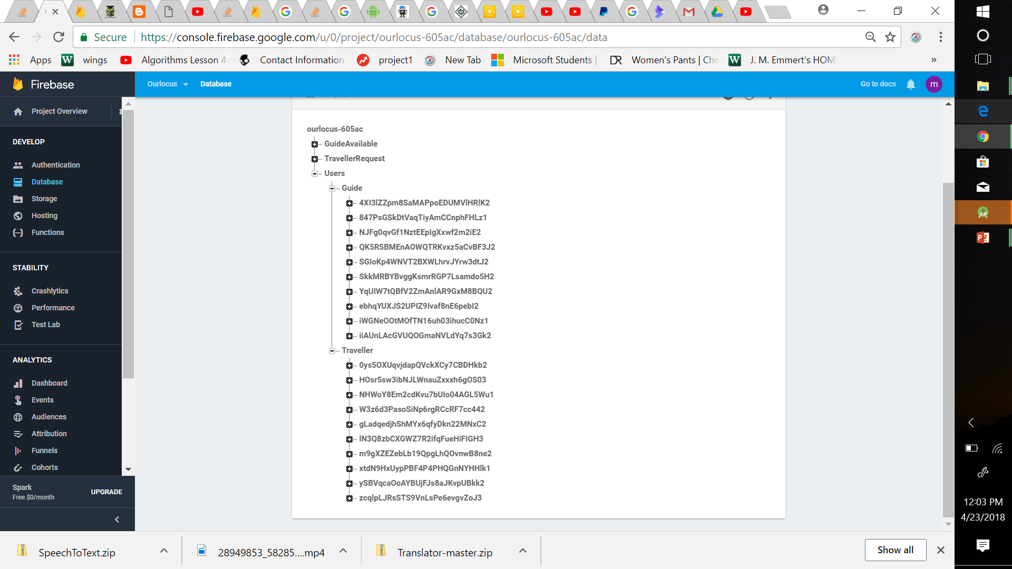

Slide 11

Demo of our Application

Slide 12
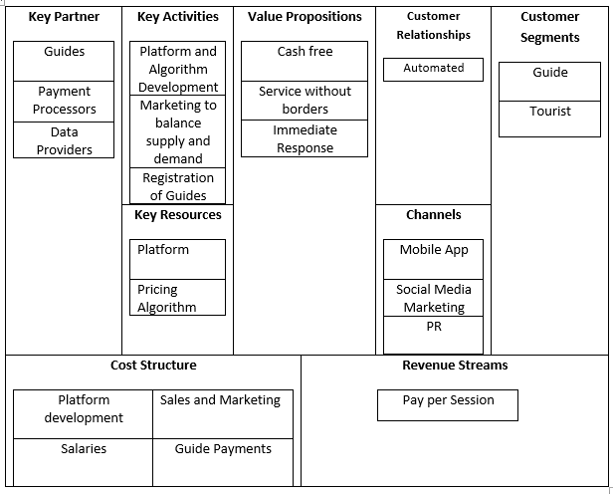
Business Model

Slide 13
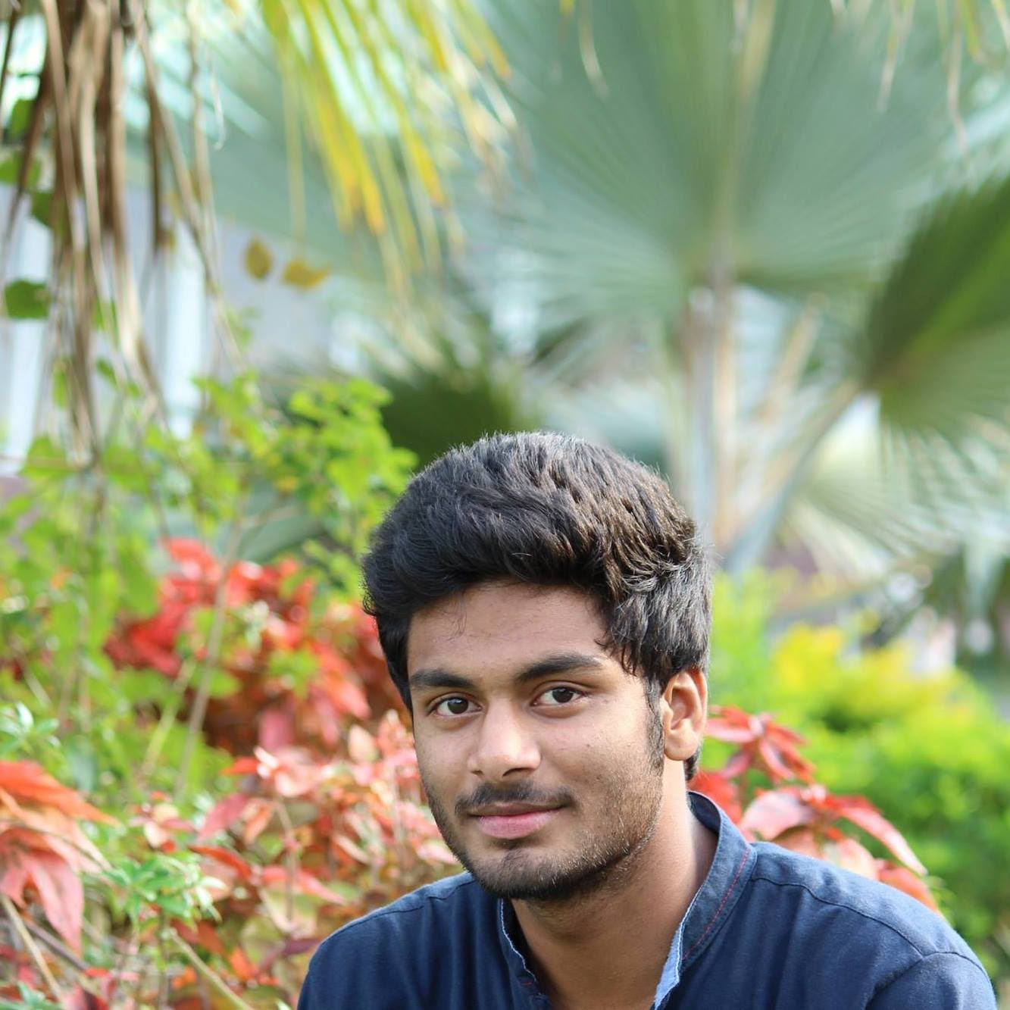
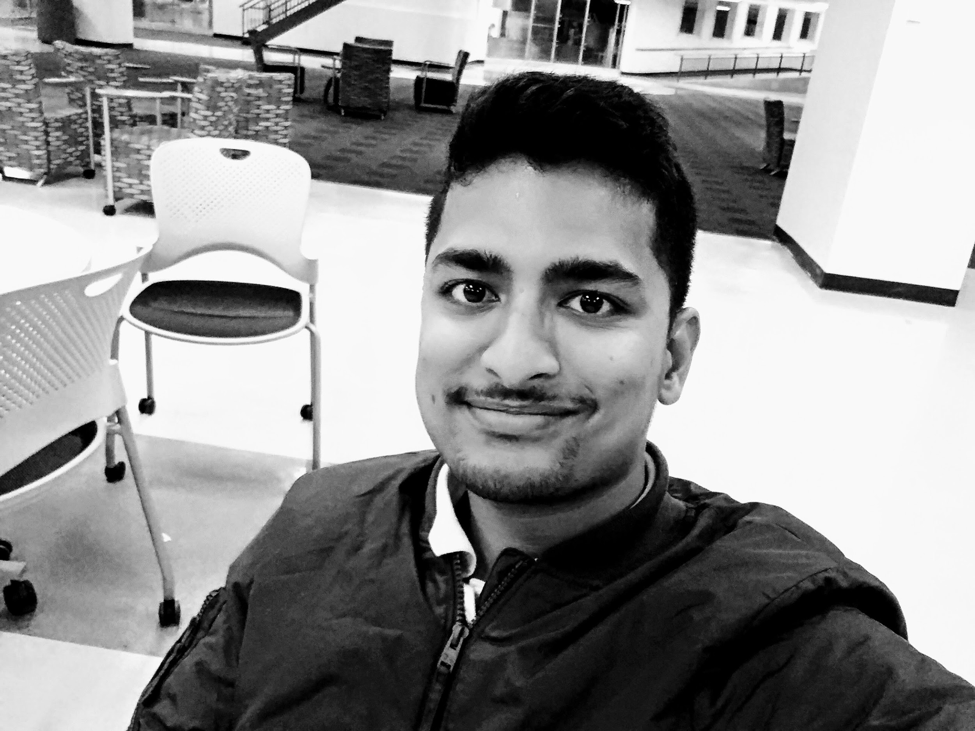
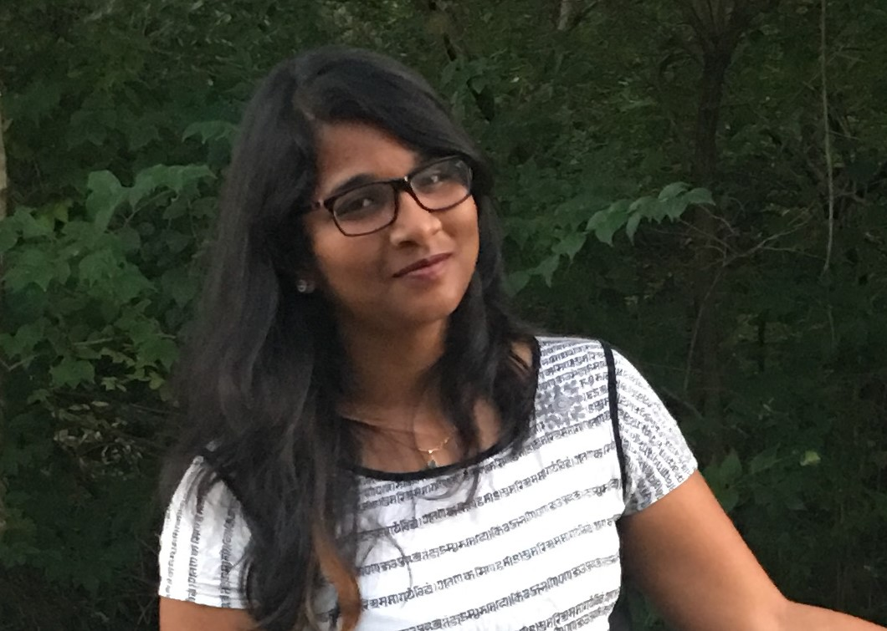
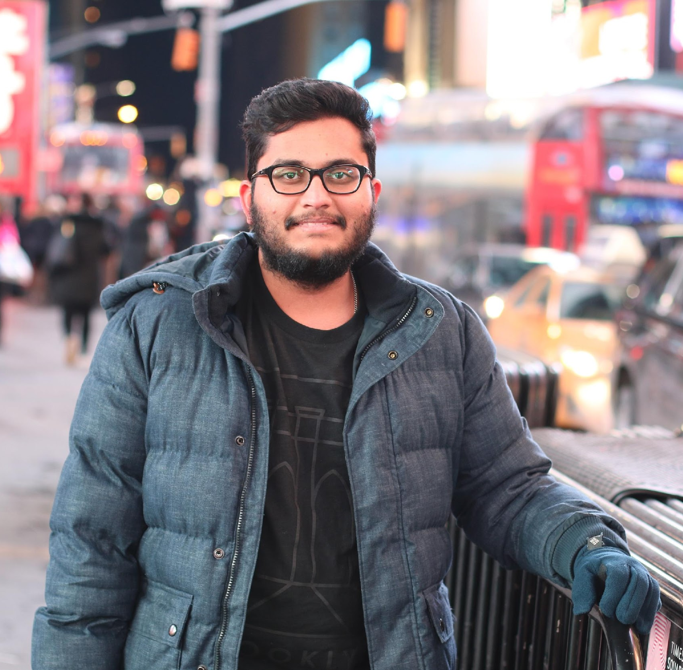
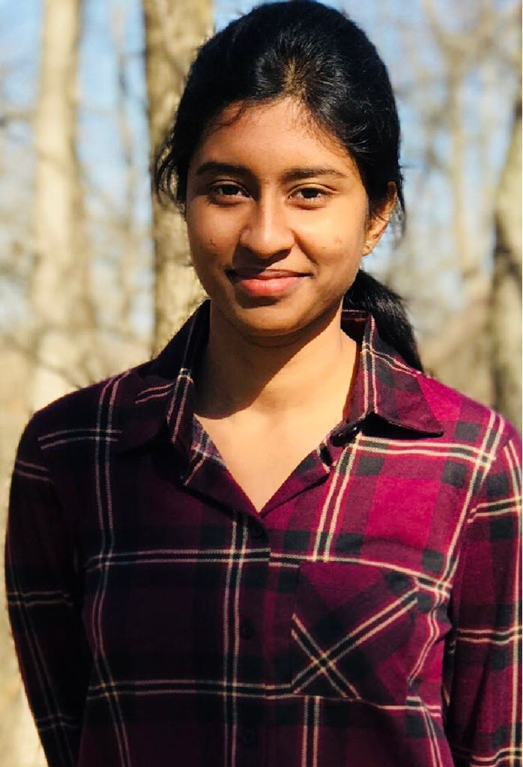
Team Contributions
BackEnd Development/App Development
Surya Praharsha
Bhargava Charan
Nethra Mugala
UX Design
Rama Chittella
Moukthika Guntha

Slide 14
Future Implementation
Start Small
Localization
Internationalization

Slide 15





Thank You
Locus
Contact No: +1(937) 516 2193
a
ㅏ
ourlocustotravel@gmail.com
@ourlocustotravel

